Slide 1

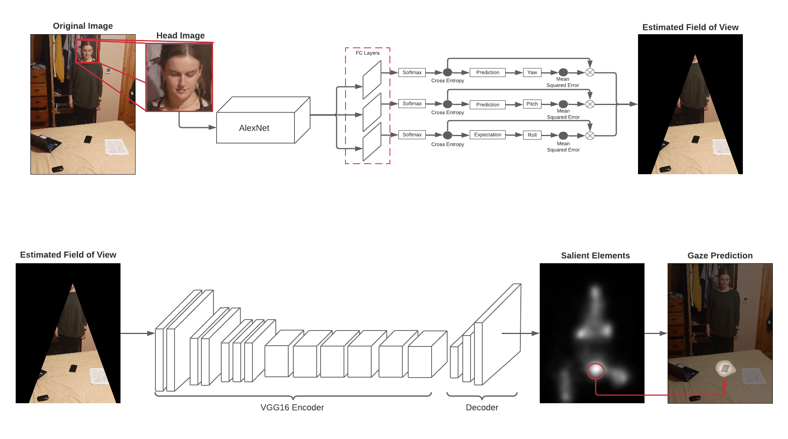
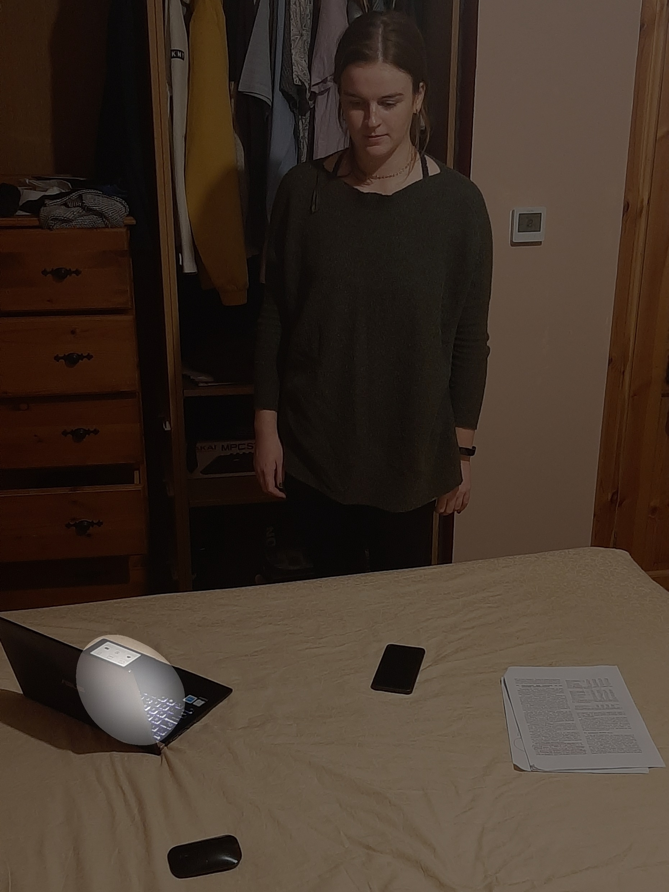
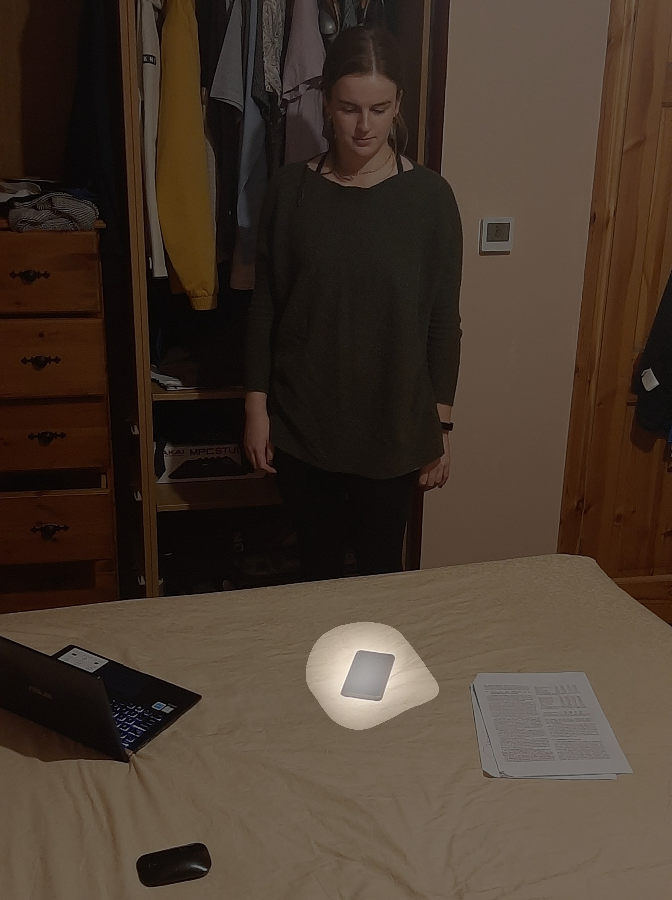
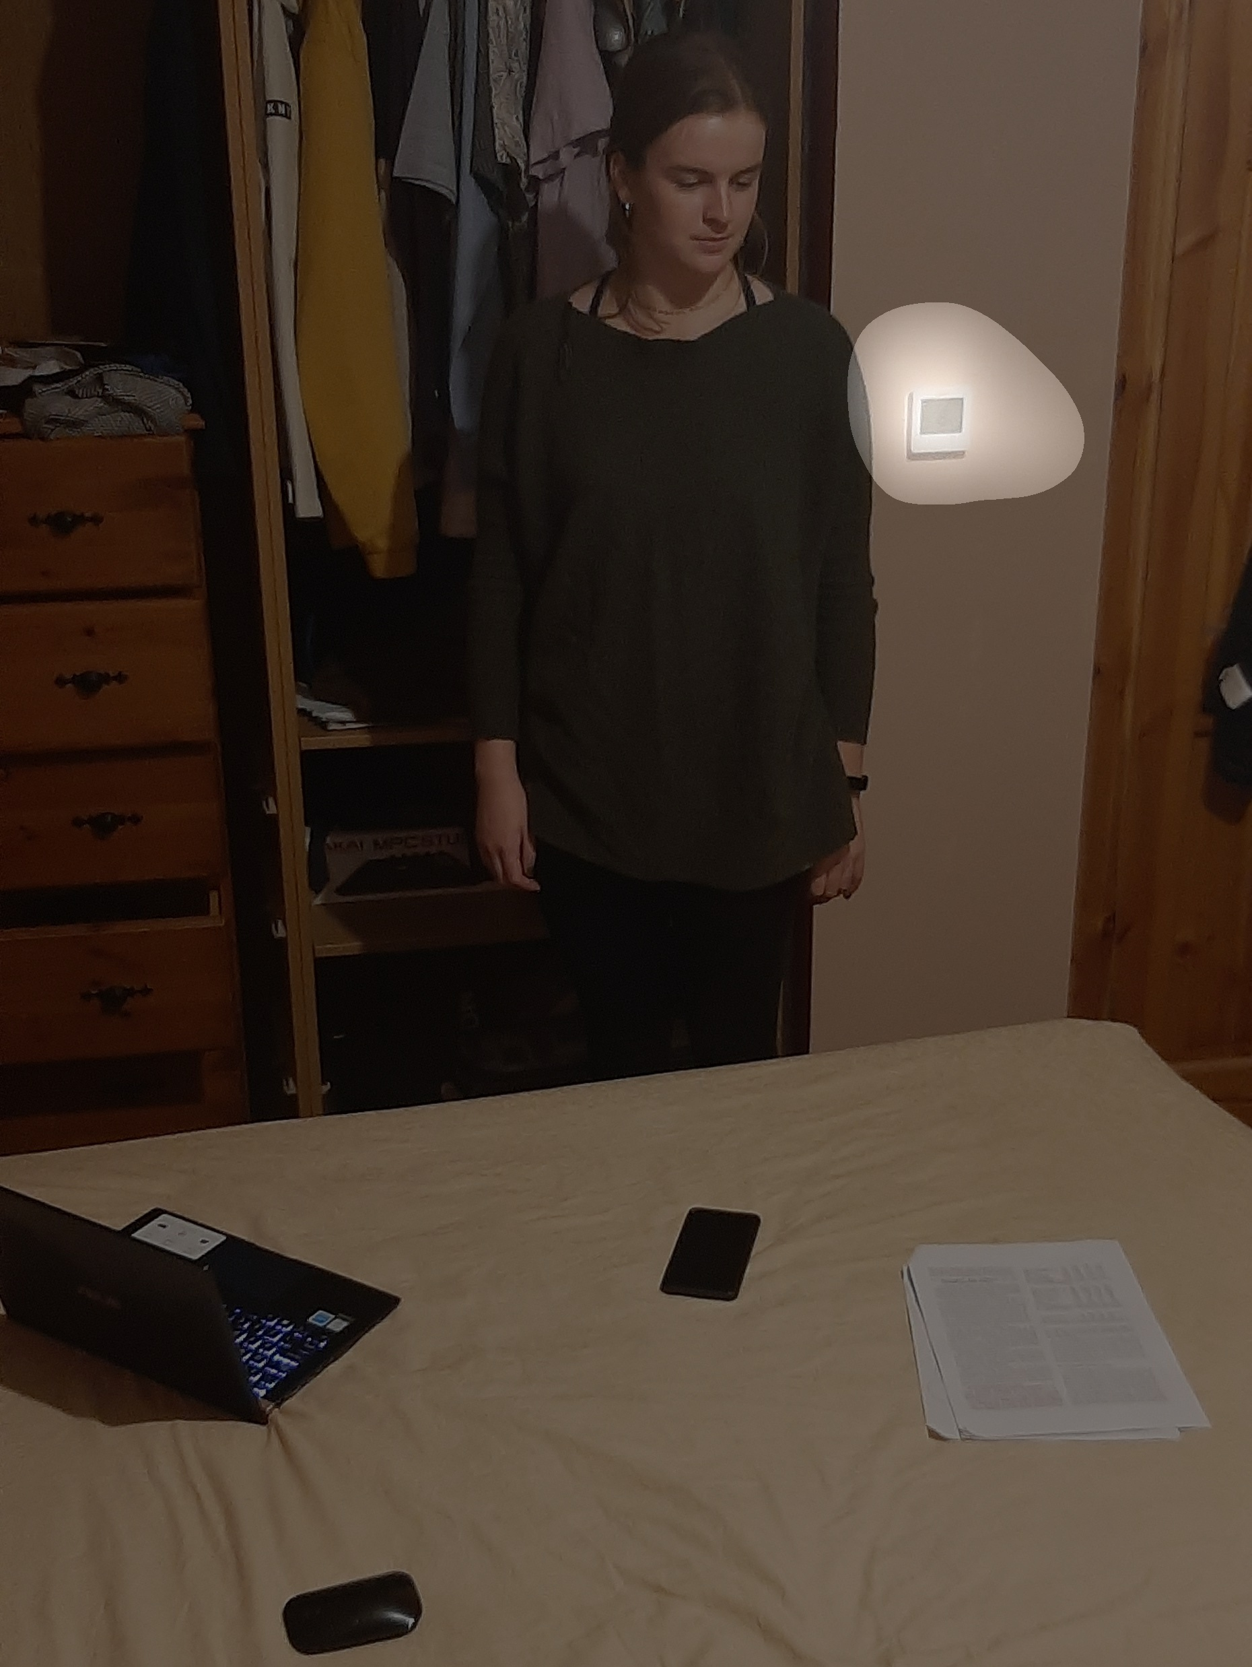





Exposition Attendee Gaze Tracking System
STUDENT: ROSS MONAGHAN – G00376556
SUPERVISOR: NIALL O’KEEFFE
COURSE: BENG(H) IN SOFTWARE AND ELECTRONIC ENGINEERING - YEAR 4
MODULE: PROJECT ENGINEERING
YEAR: 2020/2021
Introduction
Head Pose Estimation
Results
What makes a successful exposition display? This is a question businesses must ask themselves when looking to use an expo as a means to promote their brand and showcase their product. My proposal is of a computer vision system that tracks the gaze of attendees at an expo, so that detailed data may be provided to a user of what component of their display most effectively caught peoples’ eye. The result of this would be a more detailed understanding of how a display performs, so that its design may be altered to grab attention more effectively.
Main goal of developing a Gaze Estimation Program successfully completed.
Program can use the steps detailed previously, to calculate the most likely area within a frame that a person is looking.
Occasional errors in head pose estimation can cause program to give an inaccurate result.
test
Pre-trained multi-loss convolutional neural network used to estimate the Euler angles (yaw, pitch and roll) of a person’s head.
Algorithm developed to estimate the field of view of a person in an image based on the Euler angles that have previously been estimated.
Accurate Estimation
Accurate Estimation
Inaccurate Estimation
Approach
The approach taken to develop this project involved the use of a Convolutional Neural Network (CNN) to estimate a person’s general gaze direction. The resulting image is then used as an input to another CNN which estimates the saliency of objects within the predicted gaze direction. Finally, an algorithm calculates the most likely salient area that was within an individual’s gaze.
Saliency Mapping
Conclusion
Developed a greater understanding of areas such as Deep Learning, Convolutional Neural Networks, Image Processing and Mathematics.
The scope of this project focused on just a part of a larger system. It is an exciting prospect to develop this system out completely in the future.
Technologies
Pre-trained encoder-decoder convolutional neural network used to estimate the saliency of objects within the field of view that has previously been predicted.
Algorithm developed to predict the most likely salient area that is within a person’s field of view, based on how salient an area is combined with how far it is from the initial estimated head direction.
Info
GitHub: https://github.com/rmon-gmit/fyp

